Slide 1
Biases in papers by rational economists
The case of clustering and parameter heterogeneity
Martin Paldam
Paper at: http://martin.paldam.dk/
Papers/Meta-method/Rationality2.pdf

Slide 2
Continue paper from last year:
Simulating an empirical paper by the rational economist.
Empirical Economics DOI: 10.1007/s00181-015-0971-6
Very good refereeing process
Big confusion cleared up: The biases I study are due to rationality not censoring
A small literature compares economists and others: Economists are more rational.
We use our theory to predict others – must be better for us!
Hence, economists behave according to economic theory I want to use standard micro as we all know

Slide 3
All estimates: (b, t). Simplify: Size and fit are the only 2 dimensions in empirical research.
Two problems to solve: Find J and optimum (b, t)
Problem 1: Find J, the number of regressions for each published one: Our theory says:
J is where: MC(J) = MB(J), provided (i) and (ii)
  Worth for researcher to publish. (i) MB high, but falling
  It is very cheap to regress. (ii) MC low, but constant
  MC(J) = MB(J) is stable all is fine
Hence, J is large like 25-50. Thus, when a paper publish 10 estimates 250-500 are made
From now: J is predetermined

Slide 4
Problem 2: Choose the optimal estimate of the J made
The J estimates produced are the
  PPS (production possibility set), which has a
  PPF (production possibility frontier), which is the efficiency rim
Indifference curves for (b, t)
The optimal solution: where the researchers utmost indifference curves touches the PPF

Slide 5
Advertising
Pure theory:
The rational economist in research: A model available from: http://martin.paldam.dk/Papers/Meta-method
/Rational-economist-model.pdf
Version from 28/8-2015

Slide 6
Correcting censoring bias (Tom and Chris):
Have analyzed the statistical theory ➔
The FAT-PET good, The PEESE better
Problem: We do not known how these MRAs work for rationality. Maybe someone can solve analytically?
Last year 70 mill simulations of simple DGP/EM
Four results:
  Rationality always gives bias for J > 1 in the direction wanted
  The bias is robust to trade-offs between fit and size
  The FAT-PET still works rather well, PEESE less so
  The funnel width stays much the same

Slide 7
Many simplifications needed
Worst: All estimates independent: N = 500 papers publishing one estimate in each. β is always 1.
This years paper:
The N = 500 estimates are from 50 papers with 10 in each
Papers differ: Has a different β drawn from N(1, σ_{β}²)
Thus, each author look at one family of models, one data set, etc. ➔ the estimates cluster by papers.

Slide 8
The 6 parameter of the simulations
Using DGP: y_{t} = β x_{t} + ε_{t}, and EM: y_{t} = b x_{t} + u_{t}
J = 1, 2, 5, 10, 15, 23, 34, 50, with sum 140
SR = SR0, SR1 and SR2, which are truth, max t, max b
x_{t} = N(0, σ_{x}²), each observation, σ_{x} = 1, 2 and 3
ε_{t} = N(0, σ_{ε}²), each observation, σ_{ε} = 6, 10 and 14
β = N(1, σ_{β}²), β and each paper, σ_{β} = 0.15, 0.30 and 0.45
R is number of repetitions of funnels: proportional to computer time. R = 1 for 1 (fast) pc 0.7 hour.
Cases 8 x 3 x (1+2+2+2) = 168 – with 8 J-lines per table it is 21 tables. Only 9 presented!

Slide 9
Choosing R:
Rule of thumb: R = 1 for 1 (fast) pc 0.7 hour.
Pattern in results should stabilize.
Trade off: Time vs stable pattern
Pattern in b, t, std(funnel), FAT stabilize quickly
But PET fluctuates around 1
  Enlarged scale: small instabilities visible
  The 3 rejection rates FAT not 0, PET not 1 and PEESE not 1 not very stable
  Still not bad!

Slide 10
Choice of SRs. They choose one (b₁, t₁), …, (b_{J}, t_{J})
SR0 preference for truth: Choose average over the J estimates ➔ best expectation of the next estimate.
This is the altruistic SR.
  Smaller than rational one, less significant.
  Not liked by referees and sponsors. Bad for career
SR1 preference for fit. Choose b with highest t
SR2 preference for size. Choose highest b
This is the two extreme rationality rules
All rational SRs are in-between. As gap small OK.

Slide 11
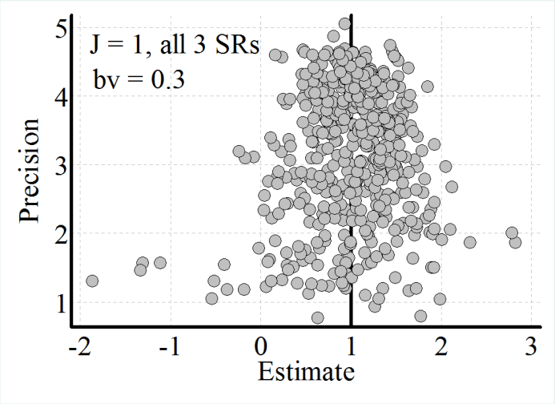
The ideal funnel for J = 1. The variation β = N(1, σ_{β}²).
Funnels get wider with rising values of σ_{β}
Old paper: σ_{β} = 0
Present paper: σ_{β} = 0.3

Slide 12
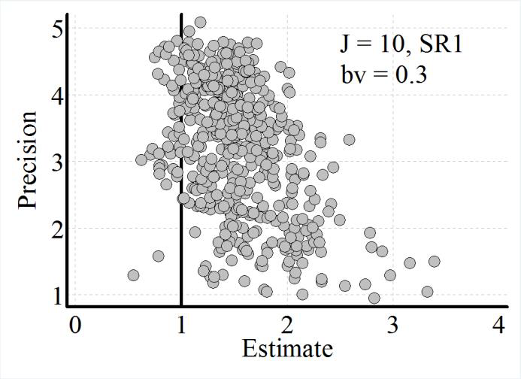
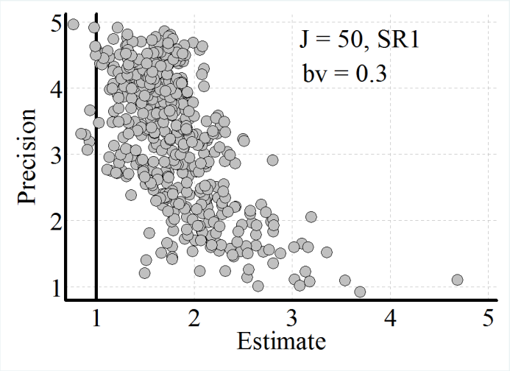
For rising values of J – same width but skewer to the right. Made for σ_{β} = 0.3
Funnels do not get very ‘sausage’ like as for σ_{β} = 0
SR1 and J = 10
SR1 and J = 50

Slide 13
Mean: For R = 1,000 and 10,000 for small Js and σ_{β} = 0.3
PS: estimates for J = 2, 3, 4 and 6 not in tables

Slide 14
The t-ratio: Same estimates

Slide 15
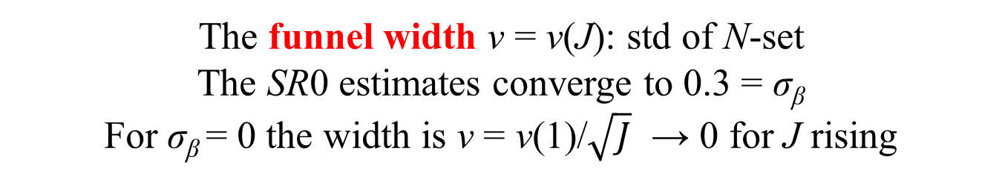
The funnel width v = v(J): std of N-set
The SR0 estimates converge to 0.3 = σ_{β}
For σ_{β} = 0 the width is v = v(1)/$\sqrt{J}$ → 0 for J rising

Slide 16
The PET. It is not made to deal with rationality, but with censoring – what our toolmaker had in mind!
Problem: We make a meta-study of 50 papers. We see a bias. Do we know how it came about?
What if rationality is common? Then we do not know the properties of the tools, but we still use them. Is this wrong?
We all do. They are tools which lies well in the hand, intuitively appealing and we have no other

Slide 17
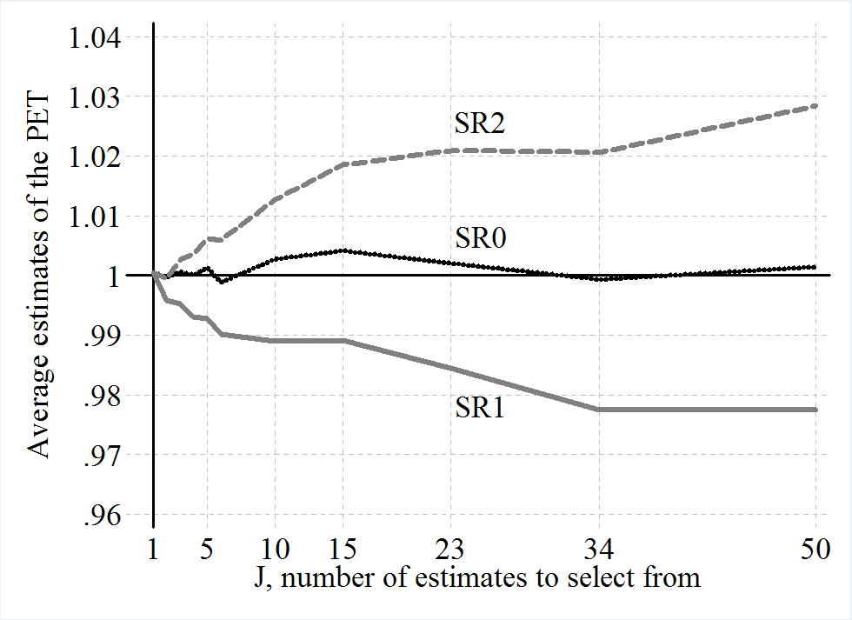
The PET same estimates. Results are 1 + 0.02

Slide 18
The PET works amazingly well. The PEESE halfway between the PET and mean. Drawings of curves in funnels: PEESE steeper too quickly.
Some plusses and minuses for PET
Problem? Rejection rates for PET = 1 is about 50% for σ_{β} = 0.3 it should reject 1 fairly often
Problem? Stability OK, but not super if R is increased 10 times ➔ 10 weeks of computer time, …
Advantage: SR1 and SR2 to different side of 1, thus any average is closer to 1

Slide 19
Thus: for J rising
The two rational SRs give much the same results. I call this rationality robustness.
I have liked Deirde McCloskey’s argument that we look too much at statistical significance (fit) and too little on economic significance, i.e. (size)
Now I know: It does nor really matter!
Also, censoring makes funnels leaner, rationality does not! Funnels become skew, but not lean. I think that this is realistic.

Slide 20
More in paper but all good things must come to an end:
Here it is:
The end

