Slide 1
A Meta-Regression Analysis of Intergenerational Transmission of Income and the “Great-
Gatsby Curve”
Francisco Perez-Arce
MAER-NET Colloqium,
Prague 2015

Slide 2
Is there a relationship between inequality and inequality of opportunity?
Concern that recent increases in inequality may make societies less “static”
Are high levels of inequality consistent with the “American Dream”?

Slide 3
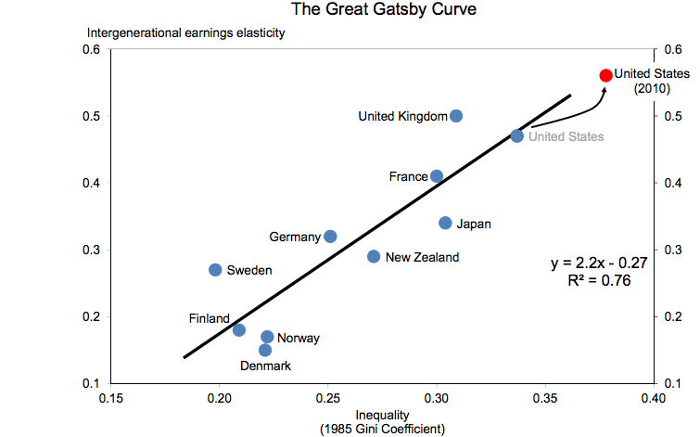
There is a cross-country correlation between income inequality and Intergenerational Elasticity (IGE) of Child to Parent Income
IGE is a measure of Intergenerational Transmission of Income (IGTI). (From a regression of child income (in logs) to (parental income)
The “Great Gabsy” Curve from Krueger (2012)

Slide 4
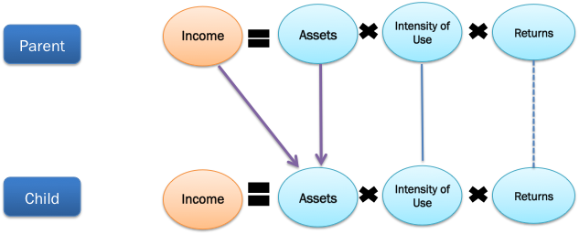
Futile to ask whether there is a causal relation
Several mechanisms lie behind the relationship.

Slide 5
Taking the Great-Gatsby Curve further:
Do different measures of Income Inequality and intergenerational transmission of income yield different results?
Does the within country (across time) changes in inequality also related to changes in IGTI
  (can be seen as the panel data version of the Great Gatsby)
Do the methodology used in estimating IGTI influence the relationships.

Slide 6
Why a Meta-Regression Analysis?
The IGE and other measures of IGTI are derived from research studies
  there are no official and comparable statistics on it.
It allows us to control for differences in methodology and context.

Slide 7
This is work in progress!
Collect studies that estimate indicators of IGTI such as : IGE, parent-child correlations, income transition matrices, rank-rank correlations
  From developed countries.
Collect indicators on methodology that may affect results:
  Gender of parents and children used
  Type of income (family/or individual)
  Number of years of parental income that is averaged
  Number of observations, etc
Match to Income Inequality data (our independent variable of interest).

Slide 8
Reproducing the “Great Gatsby”

Slide 9
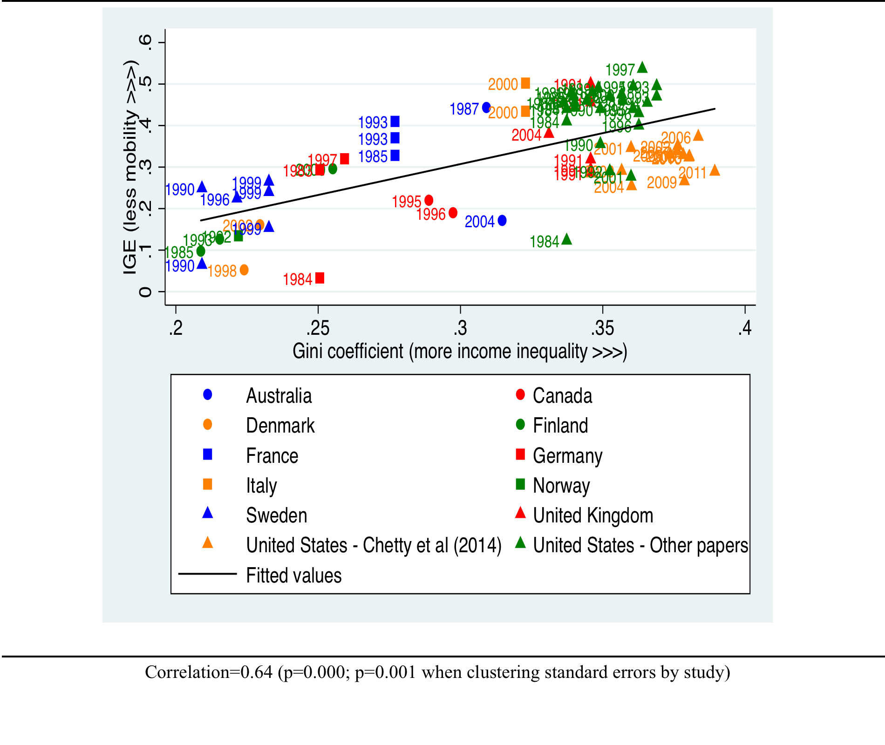
The Great Gatsby with multiple observations per country

Slide 10
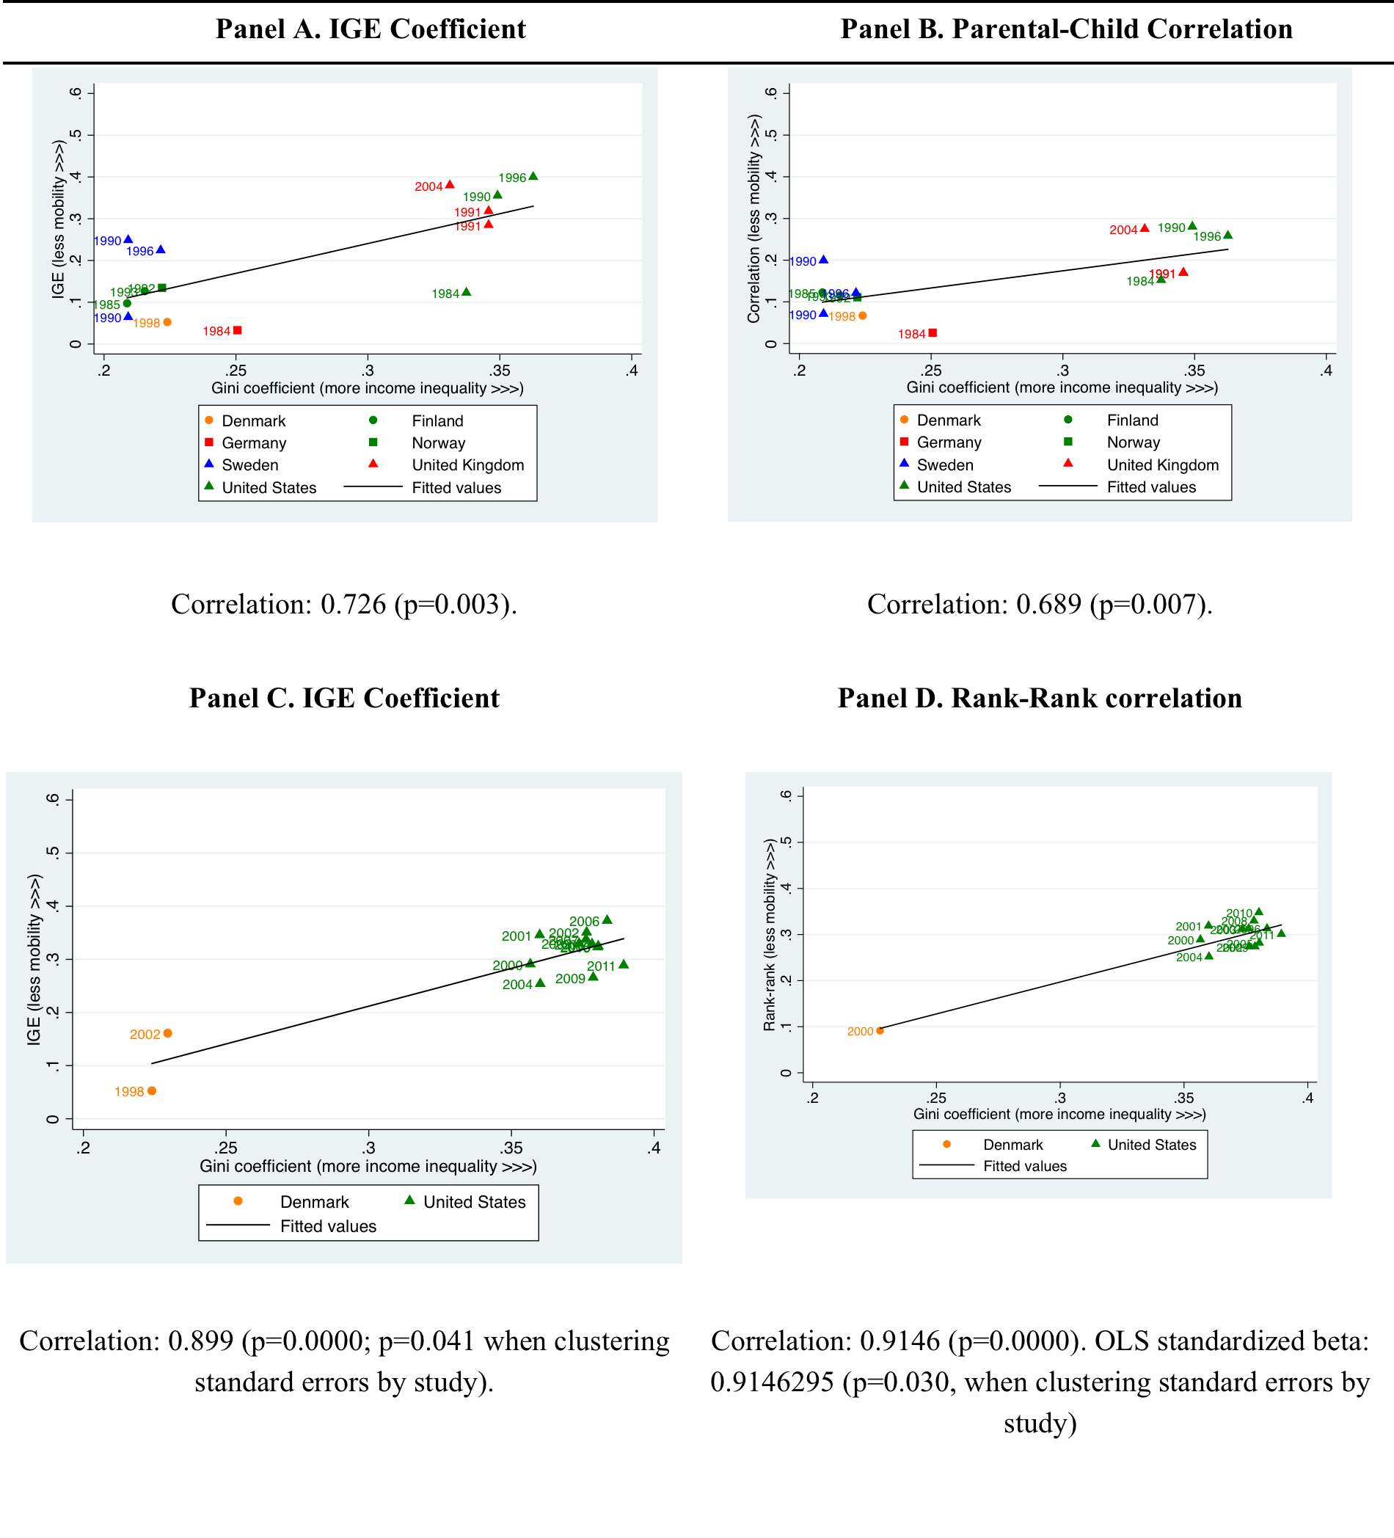
Different Measures of ITGI

Slide 11
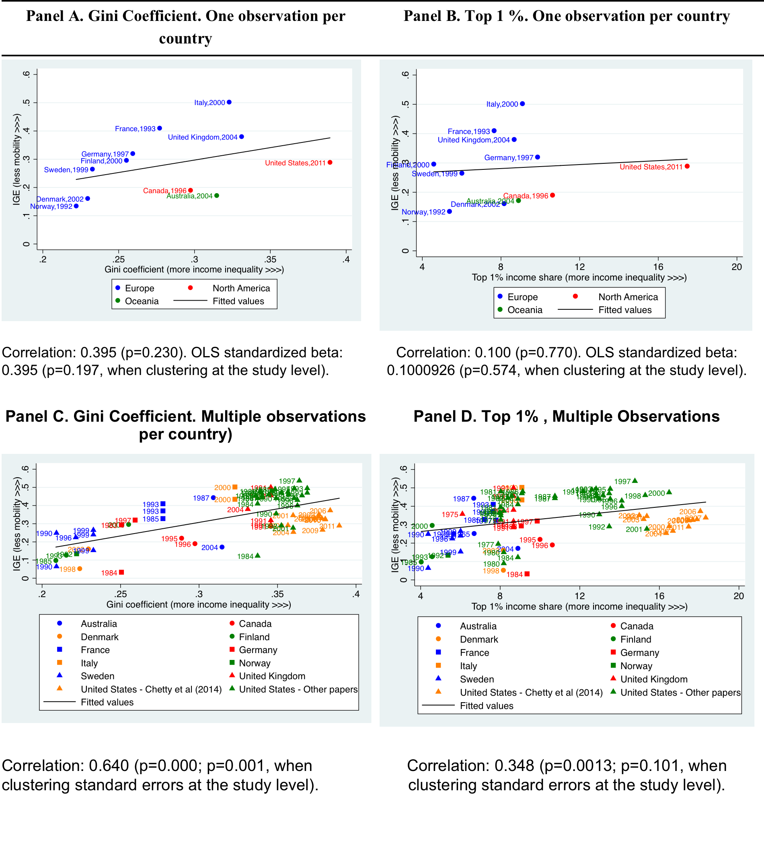

Slide 12
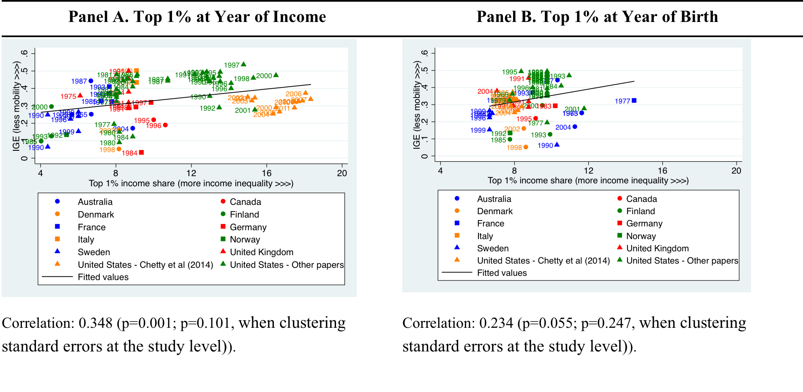
Contemporaneous Inequality more strongly correlated than childhood inequality

Slide 13
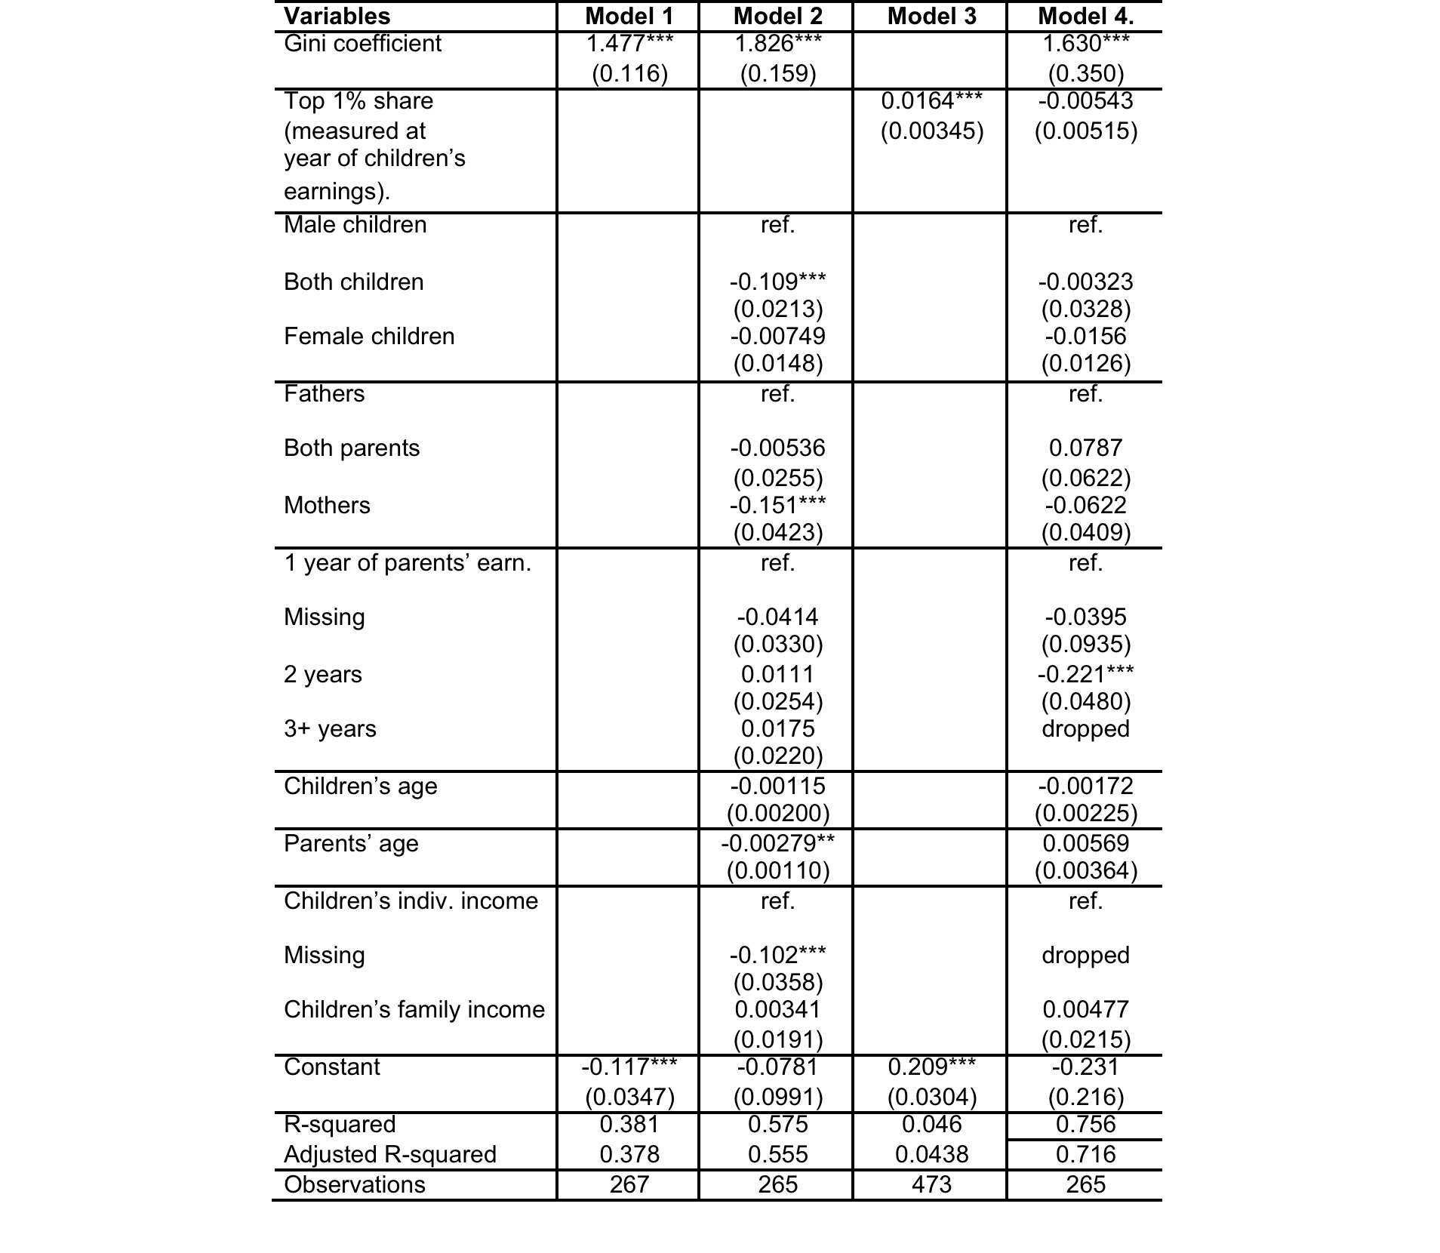
We can expand this analysis to a regression framework

Slide 14
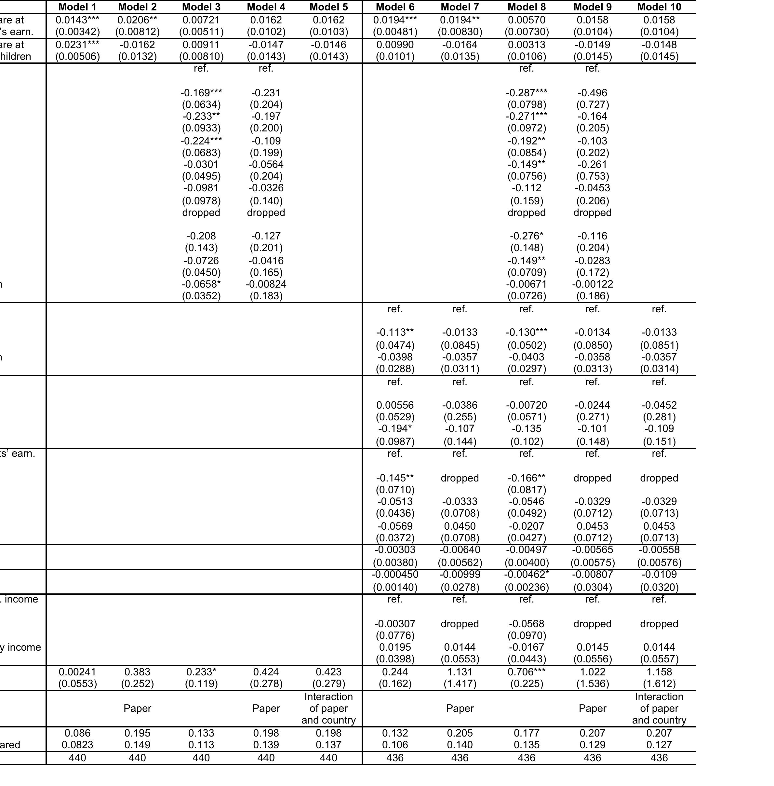

Slide 15
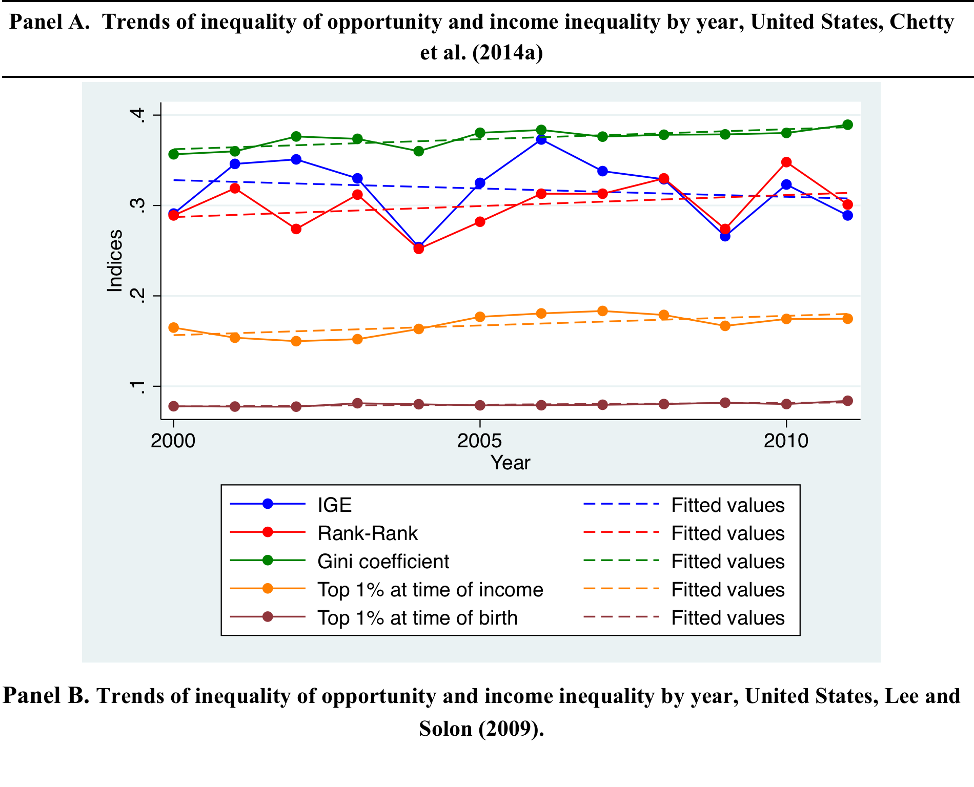
The Great Gatsby Curve Across Time (1/3)

Slide 16
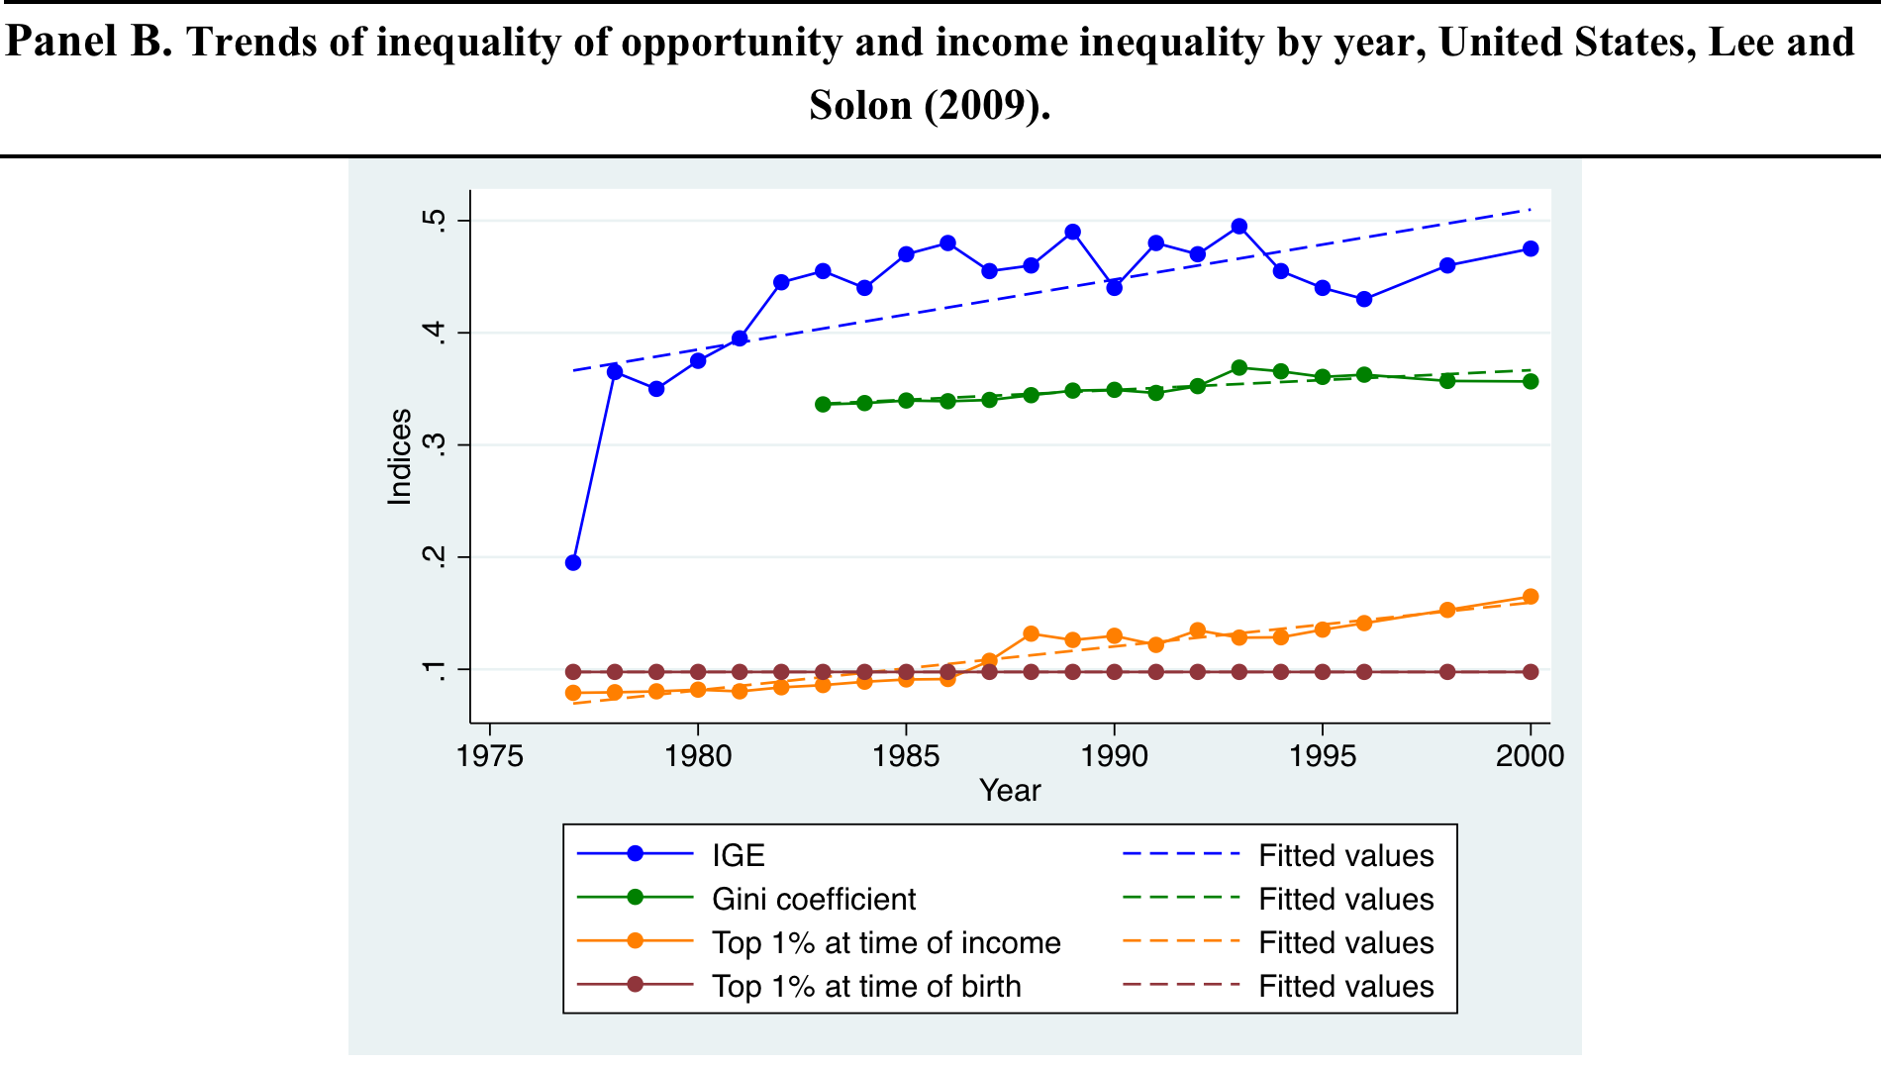
The Great Gatsby Curve Across Time (2/3)

Slide 17
The Great Gatsby Curve Across Time (3/3)
United Kingdom, Blanden and Machin (2008).

Slide 18
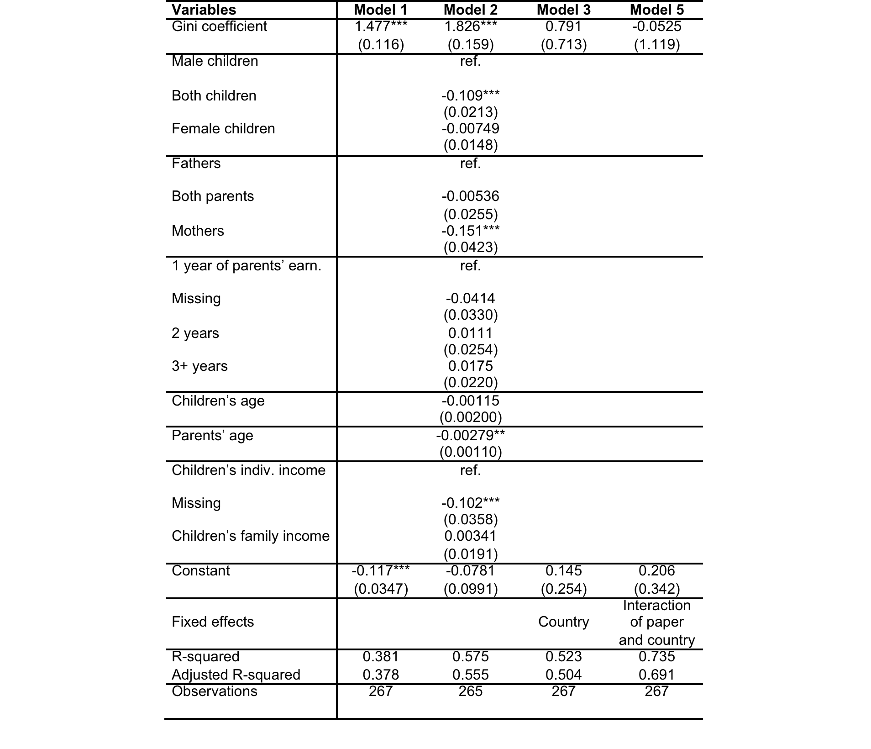
Using Country (and country/study) Fixed Effects

Slide 19
Conclusions
The Cross-Country Correlation depicted in the Great-Gatsby Curve is:
  Robust to controlling for methodology of studies
  Robust to different measure of IGTI
  Robust, but to different degrees of strength, to the “location” of Income Inequality
There is no evidence that within-country changes in Income Inequality is equally related to IGTI
Possible explanations are:
  Lack of power
  Differences in drivers of change
  Corrective policies.

